Slide 1

Theoretical Fit
Mykola Chernyashevskyy

Slide 2
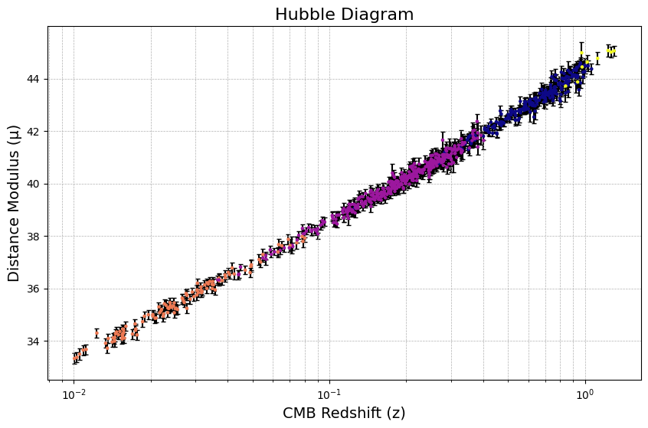
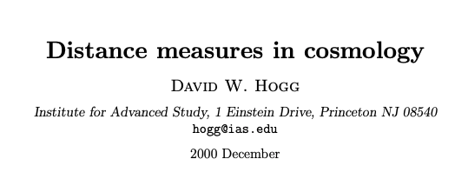
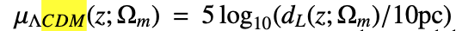
Last Meeting

Slide 3
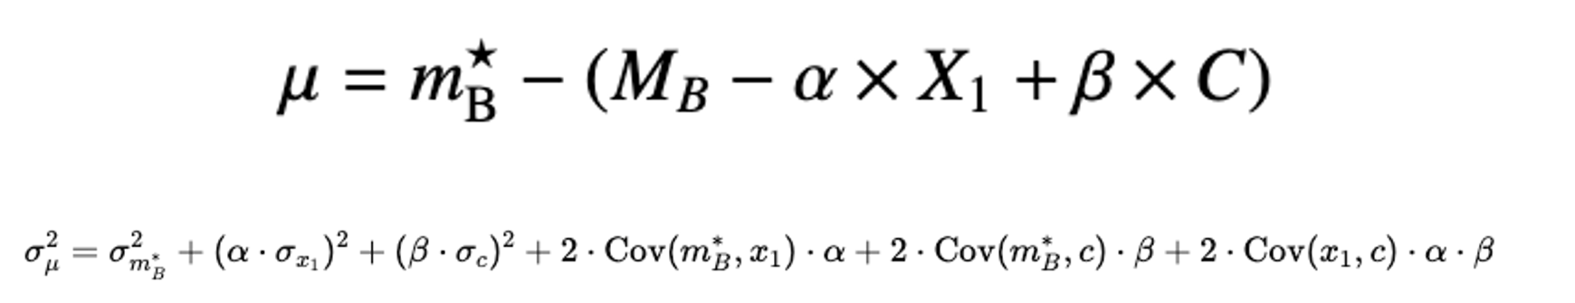
From Last Meeting – Q: Why do we exclude Mb in our error propagation? A: variability.
The uncertainty in M_{B} is an error that affects every Ia SNa the same.
Introduces a systemic effect.
The uncertainty in other variables (c, mb*, X1, B, etc.) is unique to each and every type Ia SNa.
Contributes to “the scatter” of individual measurements.
When we measure sigma mu, we’re looking at how uncertainties in variables (c, mb*, X1, B, etc.) contribute to the mu uncertainty.
You can think of it as a relative quantity because (c, mb*, X1, B, etc.) dominate variability.

Slide 4
Λ-CDM Model (Lambda Cold Dark Matter Model)
Λ-CDM is the current standard model of cosmology explaining universe composition, structure, and evolution.
Takeaway for us: Assumes the universe is flat. No curvature!
Otherwise curvature would affect the expansion of the universe and can be thought of (and modeled) as an energy density.

Slide 5
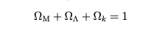
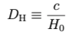
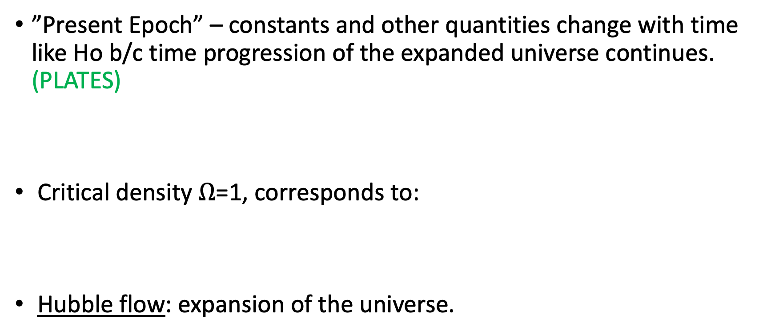
”Present Epoch” – constants and other quantities change with time like Ho b/c time progression of the expanded universe continues. (PLATES)
Critical density $Ω$=1, corresponds to:
Hubble flow: expansion of the universe.

Slide 6
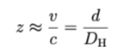
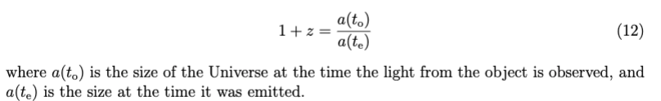
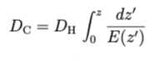
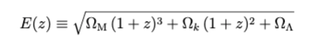
Concepts from W. Hogg
For small redshift (approximation)
Definition:
Line of Sight Comoving distance: distance that accounts for the expansion of the universe.
Comoving distance = proper distance * (1+z)
Distances don’t change over time when expressed in comoving terms.
Peebles
1993 txtbk:

Slide 7
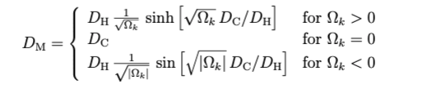
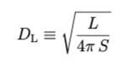
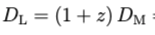
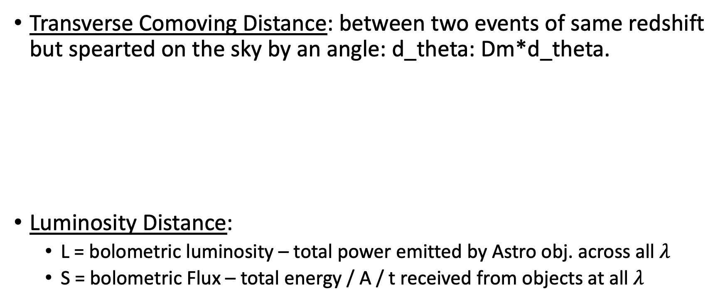
Concepts from W. Hogg
Transverse Comoving Distance: between two events of same redshift but spearted on the sky by an angle: d_theta: Dm*d_theta.
Luminosity Distance:
L = bolometric luminosity – total power emitted by Astro obj. across all $λ$
S = bolometric Flux – total energy / A / t received from objects at all $λ$

Slide 8
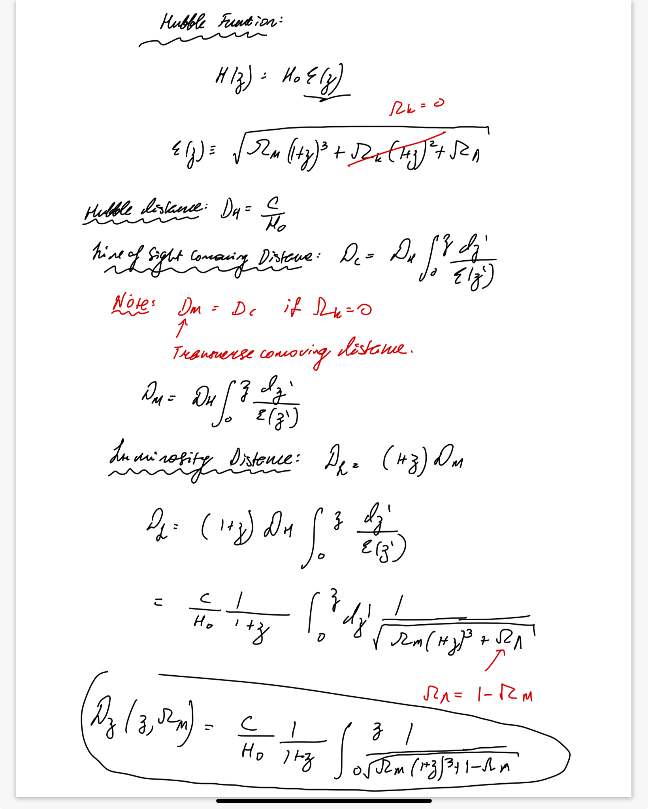
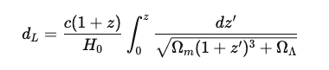
D. Hogg Paper Derivation Continued
1 – Omega_m
Plug this back into the following equation for each
galaxy:

Slide 9
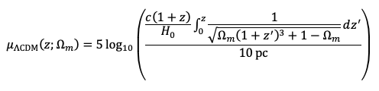
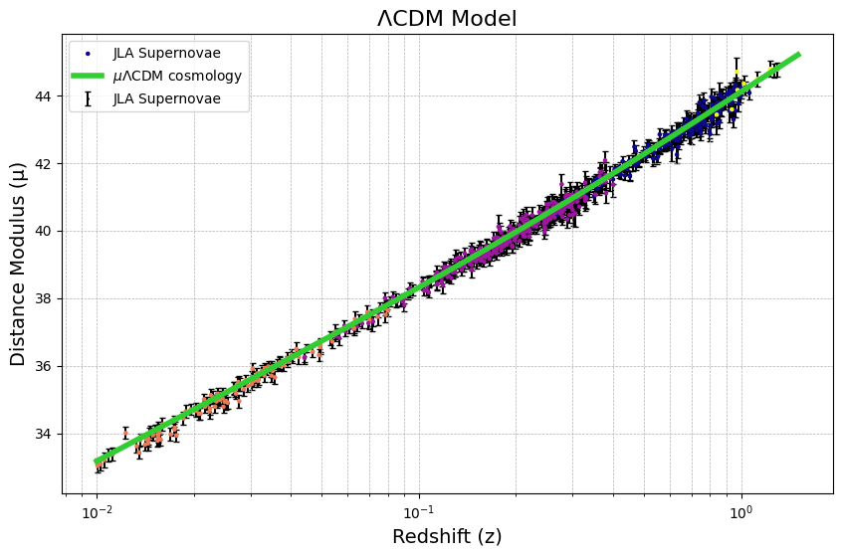
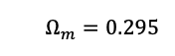
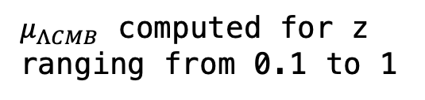
Model Fit
From Betoule et. al. (2014)
=
$μ_{ΛCMB}$ computed for z ranging from 0.1 to 1
NOTE: this is not a linear regression
Its not a straight line fit.
It’s a model fit for data.
Green line not a line: its just data points.

Slide 10
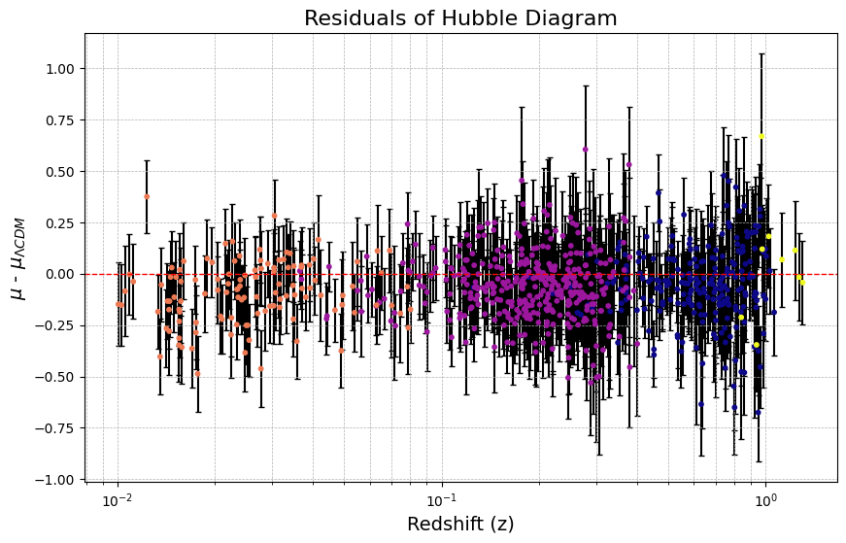
Residuals – How we Judge Accuracy of Fit
Compared to scale of the universe. The
Uncertainties are very subtle. Deviations of
+/- 1 on a scale of >40 of distance modulus
Units. Its very important to narrow down these
Constraints here.
Q: Redshift > 1. How does this come to be?

Slide 11
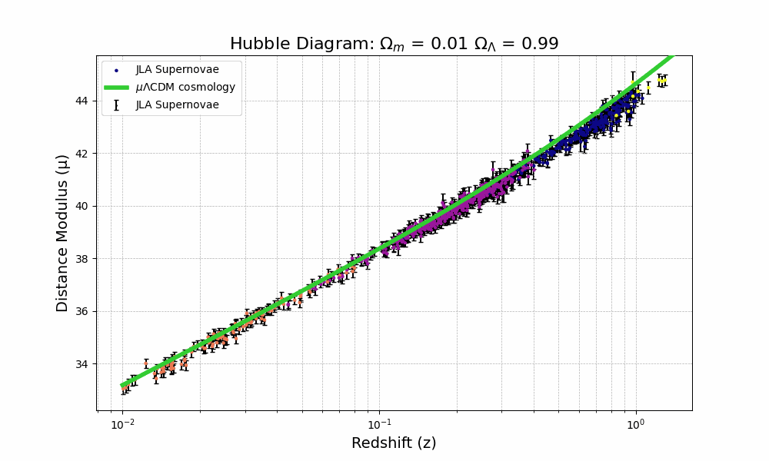
For Kyle – Demo Animation – Not a Standard Line Fit
Concept to understand: this is a log log plot.
In simple terms:
Vertical Axis is another way to plot distance.
Horizontal Axis is another way to plot speed..
Furthest and fastest moving Ia SNa are of most interest because they help narrow down Ωm.
Fit looks wrong: at limiting cases of Ωm = 0, graph is concave up, which means distant objects redshift is decelerating.
If Ωm = 1 redshift is concave down, which means its accelerating. Checked code: seems to be ok. Any thoughts?

